Slide 1
AUTOMATIC SOLAR PV COOLING SYSTEM (A GREEN ENERGY SOLUTION)
Done by
MUGHESH KUMAR N R -(RA211126050025)
YOGA VIGNESH V - (RA211126050003)
PARKAVI S- (RA211126050042)
HEPHZIBAH DINEEP – (RA211126050033)

Slide 2

GREEN ENERGY
Any energy generated or obtained from the natural resources, such as sunlight, wind or water etc. constitutes the term green energy.
Advantages:-
Clean energy;
Inexhaustible energy source;
No carbon emissions or greenhouse gases;
Energy independence;
Environmentally-friendly
GREEN ENERGY SOLUTION
A solution to harvest energy from the natural resources more effectively than the available methods. In this study, a novel solution or method to harvest more energy from the sun is proposed.

Slide 3
SOLAR ENERGY
Energy obtained from the principle energy source sun is known as Solar energy [1].
In the past few decades, researchers proposed various means to convert energy from the sun in to effective mean (electrical or thermal form) through a medium called solar energy conversion device (SECD) [2].
Among the proposed SECD’s, photovoltaic module (PVM) is a device which converts energy from the sun in to electrical form via photovoltaic effect [3].
Various classification of PVM’s are proposed by the researchers in the past one decade. However the common research problem experienced from all the proposed category remains same [4].
The electrical performance delivered by the PVM is more sensitive to its operating temperature. In other words, the electrical performance delivered by the PVM is inversely proportional to its operating temperature [5].
In order to fix this, varieties of research works are attempted by the researchers. Such works are classified in to two types. They are (i) direct-contact cooling and (ii) indirect-contact cooling of PVM.
Among the two methods, direct-contact cooling is identified as effective than the second type. Even though, rigorous effects are made to reduce or control the operating temperature of PVM, still the need to harvest more energy exists [6].
Thus, in this study a novel and automatic direct-contact cooling method for PVM is proposed. The results of this proposed PVM with novel cooling and without cooling are compared under the same operating conditions (tilt angle, latitude, longitude etc.)

Slide 4
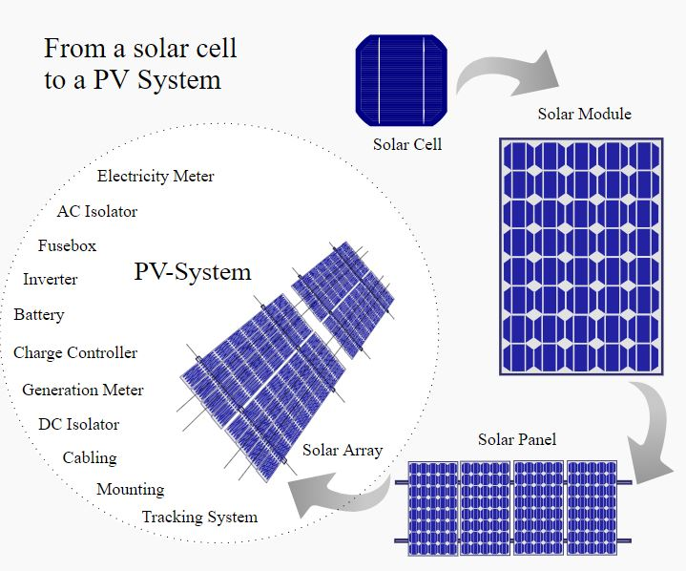
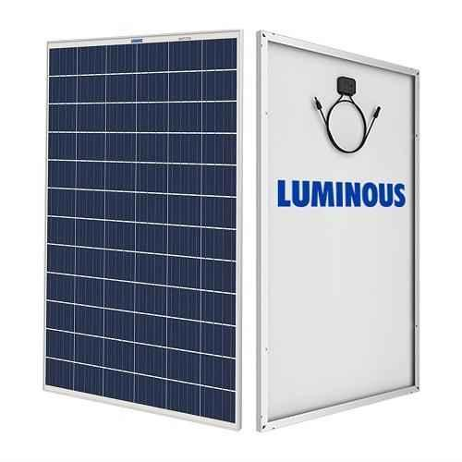
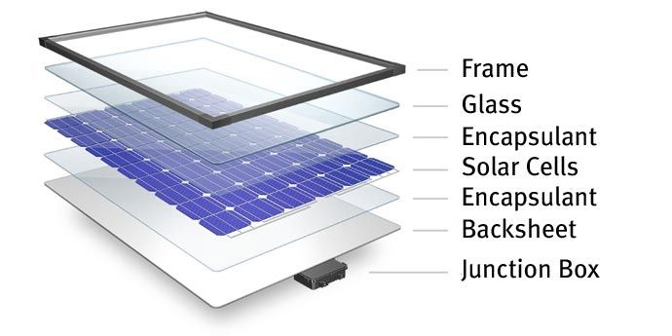
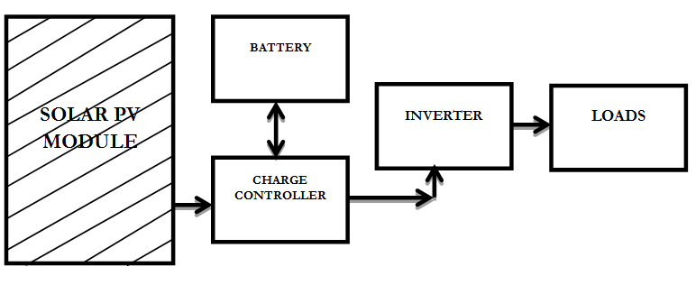
SOLAR PHOTOVOLTAIC MODULE
1
2
4
3
Figs. The PVM and its relevant theory

Slide 5
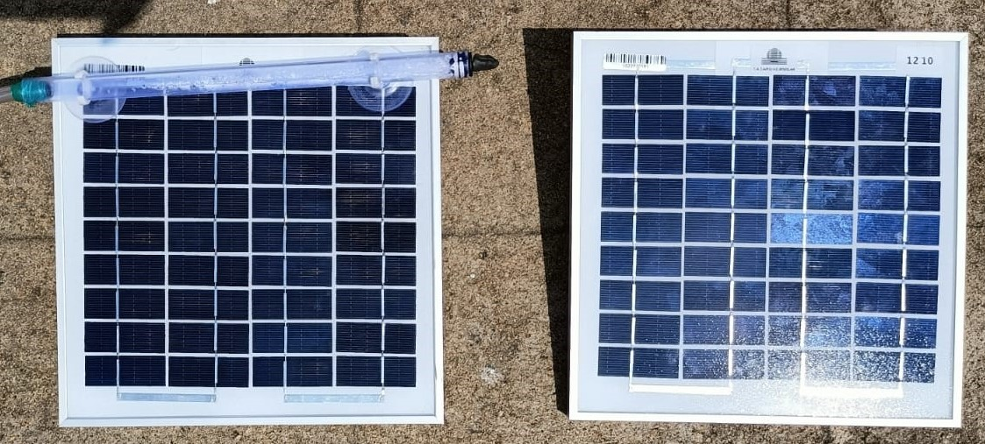
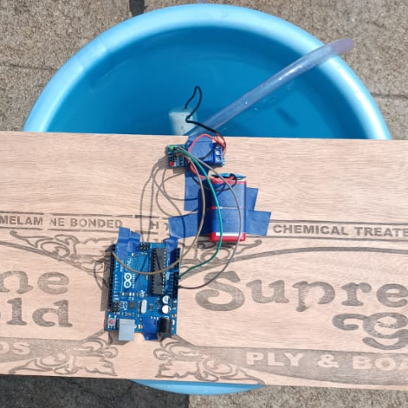
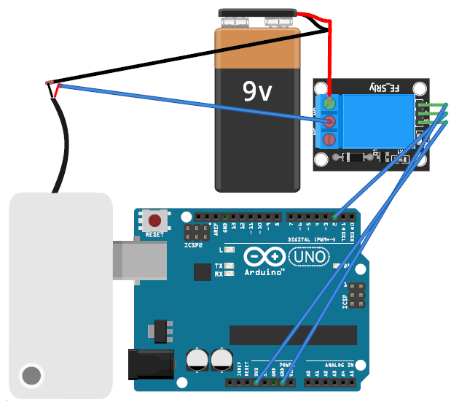
REAL TIME TEST RIG – INSTRUMENTS - SPECIFICATIONS
2
Electrical Characteristics | Ratings
Maximum Power (P_{max}) | 10W
Max. Voltage (V_{max}) | 16.8V
Max. Current (I_{max}) | 0.59A
Short circuit current (I_{sc}) | 0.65A
Open circuit voltage (V_{oc}) | 21V
Area (m²) | 0.062
1
4
3
5
https://www.youtube.com/watch?v=cjt6cJ2mp8w

Slide 6
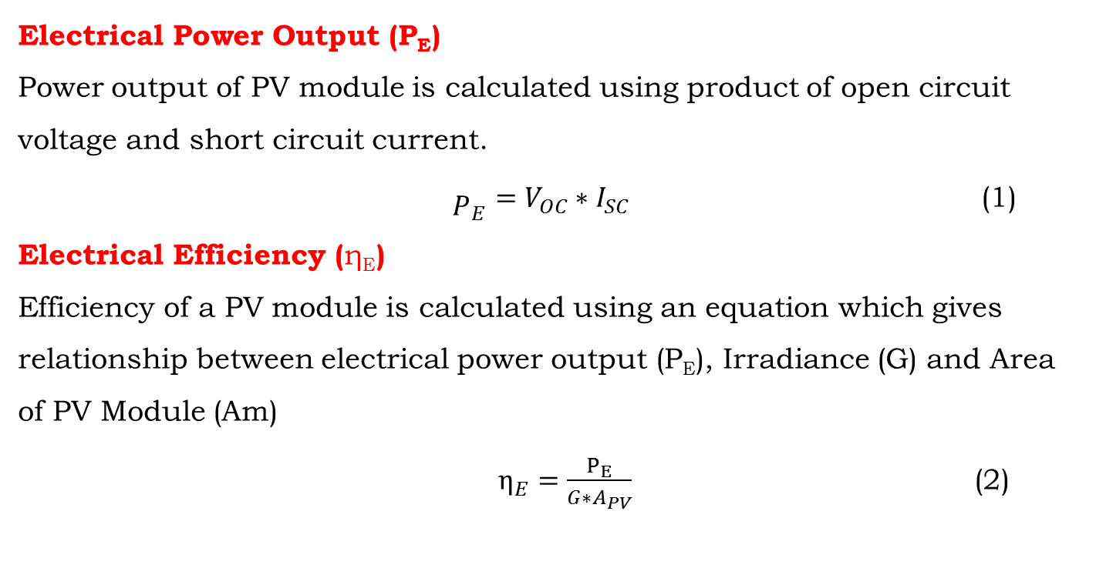
PERFORMANCE ANALYSIS OF PV MODULE
Electrical Power Output (P_{E})
Power output of PV module is calculated using product of open circuit voltage and short circuit current.
${\begin{aligned} \\ P\end{aligned}}_{E}=V_{OC}∗I_{SC}$ (1) Electrical Efficiency (η_{E})
Efficiency of a PV module is calculated using an equation which gives relationship between electrical power output (P_{E}), Irradiance (G) and Area of PV Module (Am)
$η_{E}=\frac{P_{E}}{G∗A_{PV}}$ (2)

Slide 7
Table 1 The measured electrical parameters of stand-alone solar PVM (Without Cooling)
Exp. No | t | G | U | ISC | VOC | Tm | PE | EE
 | Hours | W/m2 | m/s | Ampere | Voltage | °C | Watts | %
2 | 11 | 894.41 | 1.045 | 0.5 | 17.9 | 53 | 8.95 | 11.91
3 | 12 | 994.72 | 1.705 | 0.47 | 17.7 | 62 | 8.319 | 9.96
4 | 13 | 978.42 | 2.26 | 0.43 | 17.7 | 56 | 7.611 | 9.26
5 | 14 | 897.89 | 0.735 | 0.43 | 17.5 | 54 | 7.525 | 9.98
 |  |  |  |  |  | 56.25 | 8.10 | 10.28
Table 2 The measured electrical parameters of stand-alone solar PVM (With Cooling)
Exp. No | t | G | U | ISC | VOC | Tm | PE | EE
 | Hours | W/m2 | m/s | Ampere | Voltage | °C | Watts | %
2 | 11 | 894.41 | 1.045 | 0.5 | 19.7 | 34 | 9.85 | 13.11
3 | 12 | 994.72 | 1.705 | 0.5 | 19.3 | 37 | 9.65 | 11.55
4 | 13 | 978.42 | 2.26 | 0.5 | 19.2 | 36 | 9.6 | 11.68
5 | 14 | 897.89 | 0.735 | 0.5 | 19.1 | 35 | 9.55 | 12.66
 |  |  |  |  |  | 35.50 | 9.66 | 12.25

Slide 8
RESULTS & DISCUSSION
The operating temperature of the PVM with automated cooling system is 36.80% lower than the conventional one.
The electrical power output delivered by the PVM with automated cooling system is 16.10% higher than the conventional one.
The electrical efficiency delivered by the PVM with automated cooling system is 16.08% higher than the conventional one.
Simultaneous cooling and removal of dust particles of the PVM is attained. It may leads to higher return on investment and the life of the PVM.
Solar Irradiance (W/m²)
Fig. Variations in the module temperature of conventional and novel PVM with respect to the irradiance.
Solar Irradiance (W/m²)
Fig. Variations in the electrical power output of conventional and novel PVM with respect to the irradiance.

Slide 9
APPLICATIONS
Flexible to all the situations where PVM is used for power generation.
(Ex. Domestic, Industrial, E-Vehicles, Street lights etc.)
CONTRIBUTIONS TO THE SOCIETY
A novel, automated, simple and flexible approach to reduce the operating temperature of the PVM.
Power loss due to the accumulation dust particles will be reduced significantly.
FUTURE WORK
It involves the design of IoT controlled cooling system with the capacity to actuate based on the variations in the temperature of the PV module using Raspberry-Pi board.

Slide 10
REFERENCES
Jonas, L., Godoy, M., and Alberto, F., 2020, “Feasibility of Water-Cooled Photovoltaic Panels under the e Ffi Ciency and Durability Aspects,” Sol. Energy, 207(November 2019), pp. 103–109.
Talebnejad, R., Kamfiroozi, S., Ebadi, H., Hossein, S., Reza, A., Ghobadian, B., and Savoldi, L., 2022, “A New Cooling Method for Photovoltaic Panels Using Brine from Reverse Osmosis Units to Increase Efficiency and Improve Productivity,” Energy Convers. Manag., 251(November 2021), p. 115031.
Fakouriyan, S., Saboohi, Y., and Fathi, A., 2018, “Experimental Analysis of a Cooling System Effect on Photovoltaic Panels’ Efficiency and Its Preheating Water Production,” Renew. Energy.
Hadipour, A., Rajabi, M., and Rashidi, S., 2021, “An Ef Fi Cient Pulsed- Spray Water Cooling System for Photovoltaic Panels : Experimental Study and Cost Analysis,” Renew. Energy, 164, pp. 867–875.
Universiti, P., Abdul, J., and Tan, M., 2019, “Science Direct Investigating the Performance Improvement of and a Photovoltaic System in a Tropical Climate Using Water Cooling Method Assessing the Feasibility of Using the Heat Demand-Outdoor District Heat Demand Forecast,” Energy Procedia, 159, pp. 78–83.
Bahaidarah, H. M. S., 2016, “Experimental Performance Evaluation and Modeling of Jet Impingement Cooling for Thermal Management of Photovoltaics,” Sol. Energy, 135, pp. 605–617.

Slide 11
THANK YOU

